Slide 1
Monolith Applications

Slide 2
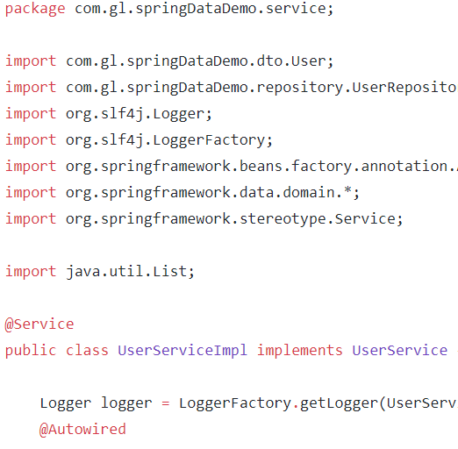


Online Shopping Portal
C
O
N
T
R
O
L
E
R
L
A
Y
E
R
D
A
O
L
A
Y
E
R
Product Management
Database
Account Management
Payment Management
Login Management
Order Management

Slide 3
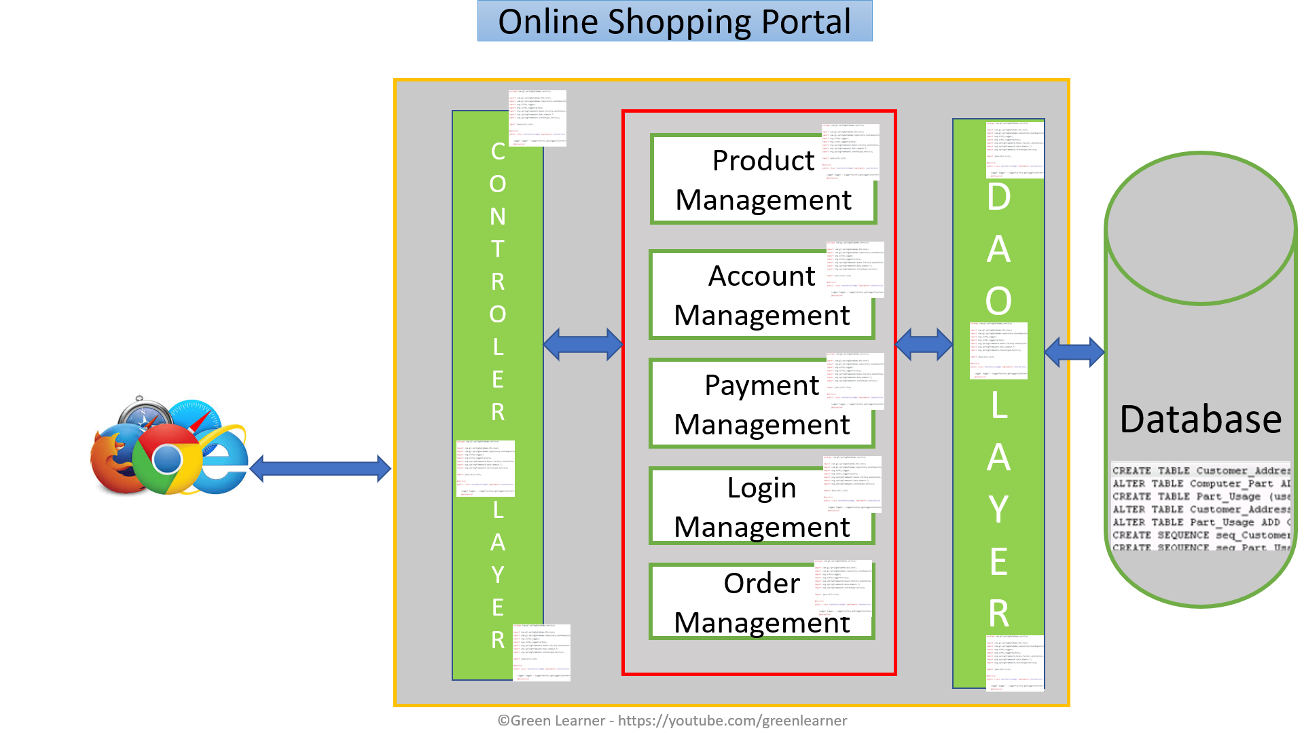
Monolith – positive aspects
Simple testing
Quick deployment
Easy to develop

Slide 4
Monolith – positive aspects
Easy to scale by having multiple copy of same application(horizontal scaling)
Less technicality
Better for small scale apps

Slide 5
By the time company grows
so the application

Slide 6


Online Shopping Portal
C
O
N
T
R
O
L
E
R
L
A
Y
E
R
D
A
O
L
A
Y
E
R
Product Management
Database
Account Management
Payment Management
Login Management
Order Management

Slide 7
Monolith – Challenges
Limitation in size
Complexity grows with time
Long time to release new features
Even small change in one module needs redeployment of whole application
More time to send the fix for production bug

Slide 8
Monolith – Challenges
High Dependency on few human resources
Hiring new team and making them understand whole application is tough
Stuck in one technology
Single point failure

Slide 9
Monolith – Challenges
Continuous deployment is difficult
Difficult to scale when we have large code base
High coupling between modules
Reliability and availability problem

Slide 10
What’s the solution then??

Slide 11
Microservices

Slide 12
Online Shopping Portal
Database
G
A
T
E
W
A
Y
Product Management
Database
Order Management
Database
Account Management
Database
Payment Management
Login Management
Database

Slide 13
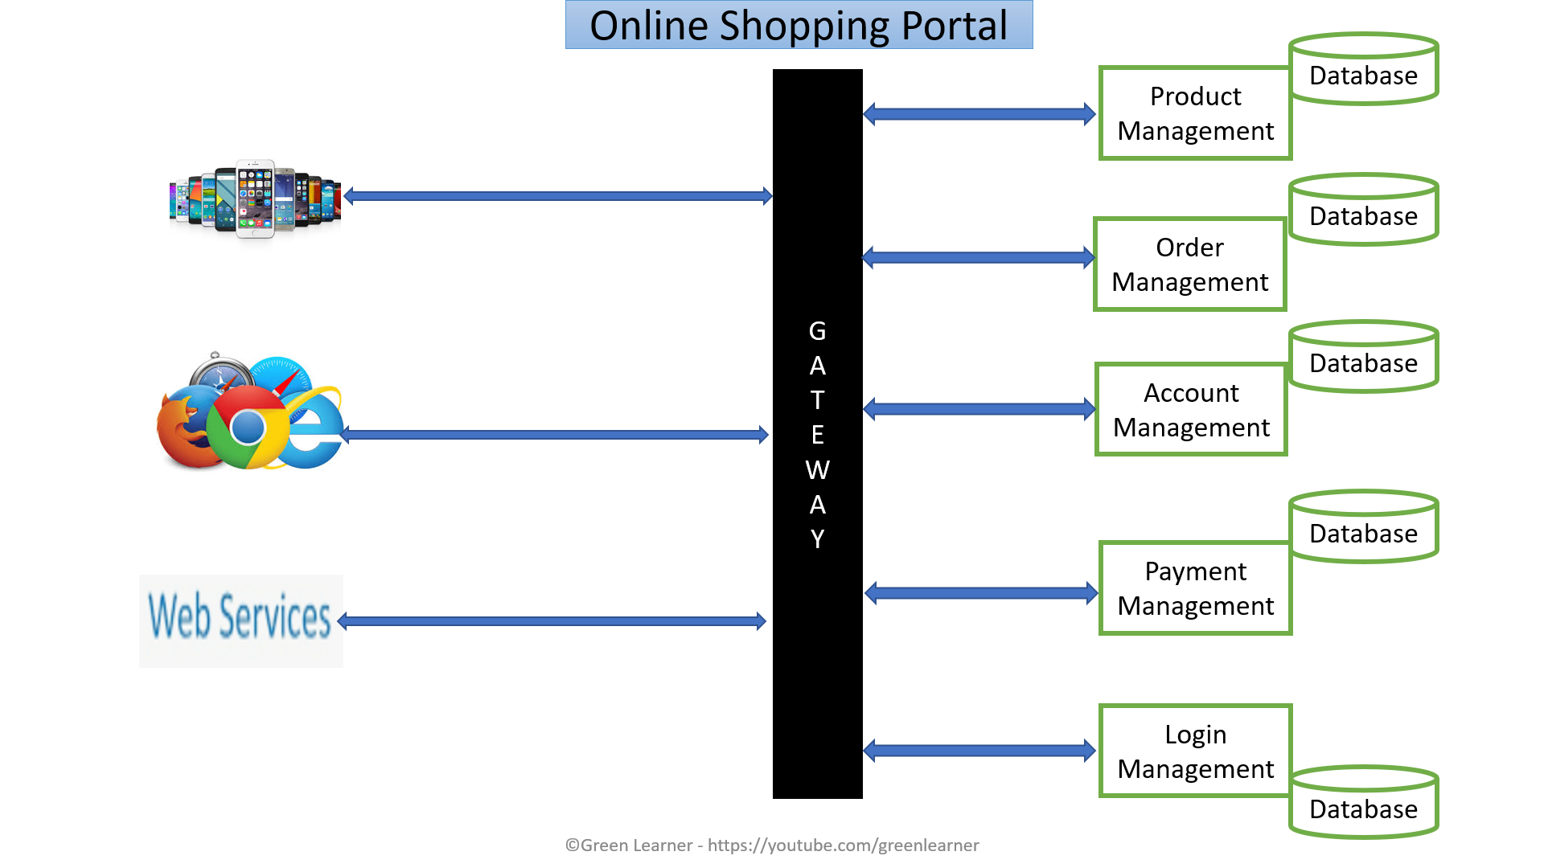
Microservices : Positive aspects
Domain expertise
Easy and quick to scale – on demand
Isolated decision making
Self Organisation
Quick response to change
Increase uptime
Can experiment with any tech
Loose coupling
Service reusability
Agile, SCRUM
Best for large scale apps

Slide 14
Microservices :Challenges
Additional complexity with distributed systems
Service Discovery
Monitoring complexity with Service Boundaries
Data Consistency
Communication among services is challenging
Testing each service is also a challenge
Maintaining transnationality among services

Slide 15
Fundamental problems with Monoliths which can’t be solved without changing the architecture??
Response to change – bug fix or adding new feature
On demand scaling
Flexibility
Adopting new technologies for better performance

Slide 16
What next??
Microservices : Design Patterns

Slide 17
Why??
We need our services to be highly
Available
Scalable
Resilient to failures
Efficient
Design patterns help in solving the specific microservice architecture challenge
Design patterns help in reducing risk of failure in microservices

Slide 18
What are Design Principles??
Independent/ Autonomous
Resilient/ Fault Tolerant/ Design For Failure
Observable
Discoverable
Domain Driven
High Cohesion
Single Source Of Truth
Decentralization

Slide 19
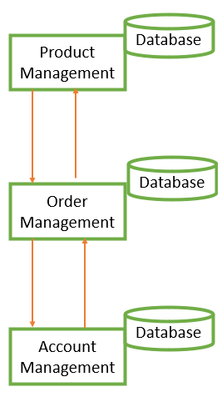
Small team size
Parallel development
Clear contracts
Individually deployable
Independent/ Autonomous

Slide 20
Avoid single point of failure
Avoid cascading failure
Consider failure as events and analyse it properly
Resilient /
Fault Tolerant / Design For Failure

Slide 21
Centralized monitoring
Centralized logging
Health check system
Observable

Slide 22
All services should be registered at one place
It makes client’s life easy when looking for specific service
Discoverable

Slide 23
Focussed on business
Focussed on core domain
Focus on Domain logic
Domain Driven

Slide 24
Database for each service
Choice of database depends on the nature of particular service
Decentralization

Slide 25
Do one thing only
SRP
A business function
A business domain
Easy to take new similar feature
Why
Scalability
Availability
Database
Product Management
High Cohesion
Database
Order Management
Database
Account Management

Slide 26
There should be only one source to get the complete information
This helps in avoiding the duplicity
Single Source Of Truth

Slide 27
What are those patterns??
Decomposition
Database
Resiliency
Integration
Observability
Cross-cutting concern
Event Driven

Slide 28
Decomposition patterns
Database patterns
By business capabilities
By subdomain
Strangler pattern
Sidecar pattern / Service mesh
Database per service
Shared Database
CQRS
SAGA
Event Sourcing

Slide 29
Communication Among services
Synchronous
Async - event/messag based
Communication Medium
HTTP REST - xml/json
Graphql
gRPC
Integration patterns
API gateway
Aggregator pattern
Chained Pattern
Branch pattern
client side UI composition patterns

Slide 30
Deployment patterns
Multiple service instances per host
Service instance per host
Service instance per VM
Service instance per Container
Server less
Blue green
Canary

Slide 31
Observability
Log aggregation
Performance metrics
Distributed tracing
health check
Cross Cutting Concern Patterns
external configuration
service discovery pattern
circuit breaker pattern

Slide 32
What next??
Decomposition Pattern : By Business Domain and subdomain

Slide 33
There are 2 kinds of project under microservices
Monolithic to Microservices – Brown Field Projects
Microservices in nature from scratch – Green Field Projects

Slide 34
How to decide the size of microservice??
Business functionality

Slide 35
How to decide the size of microservice??
Order Management
Placing order
Order tracking
Invoice generation
God Classes
Shared among different modules
Sub domain
Domain Driven Design
Bounded context

Slide 36
What next??
Decomposition Pattern : Strangler

Slide 37
Account Management
Product Management
Product Management
Account Management
Route
Product Management

Slide 38
Transform
Co-Exist
Eliminate

Slide 39
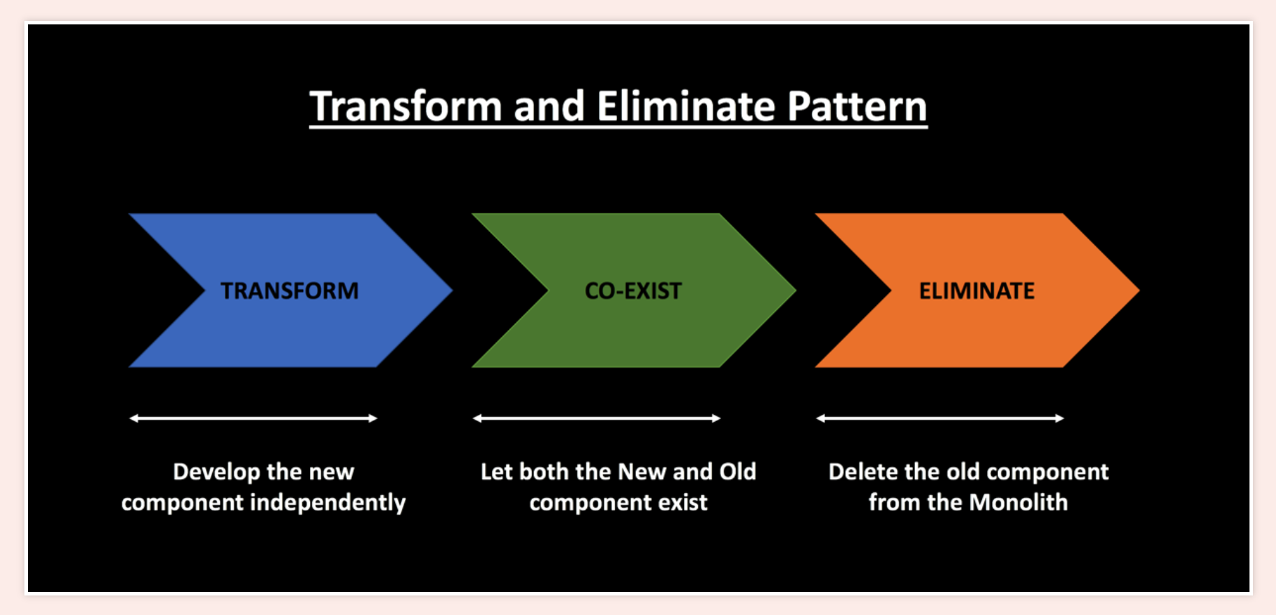

Slide 40

Strangler fig

